Slide 1

Trust in Law Enforcement:
Understanding the Drivers of Police Sentiment Scores
Notes:
Good day, classmates, prof Chris, and mentors. I’m here to present do you today my research into what drives perceptions of police trustworthiness and safety.

Slide 2

Case File #ML1
Objective:
Build a model to predict the degree to which police are trusted by members of their community.
Location: Chicago, IL, USA
Methodology: Regression modelling
ML1
Notes:
My mission objective was simple. My task was to build a would model that would predict the results of a police sentiment survey, identifying to what degree a community trusts their police force, and feel that their local law enforcement treat them with respect. Much attention has been brought to this issue in the US, with controversies surrounding Black Lives Matter and police brutality, however it’s not relevant in the US only. This may be considered important in other countries as well, including the Philippines, to guide law enforcement on how to build trust and rapport within their communities.
The study would focus on community areas in the city of Chicago, and different regression models would be tested. Considering the subject matter, a main objective here is interpretability, because if the model is too obscure it would not convince anyone on a jury.

Slide 3



Lay the groundwork. Investigation requires thorough research.
Case Learning #1:
Illinois Department of Public Health (IDPH)
Chicago
Metropolitan
Agency for
Planning
(CMAP)
Socio-
Economic
data
Demographic
data
Public
Health
indicators
U.S. Census Bureau
Crime reports
Chicago Police Department
Geographic data
Target variable:
Police
Sentiment Scores
Chicago
Police Department
&
Elucd
Wikipedia
Design Matrix
Notes:
As I proceeded with my investigation, a number of insights presented themselves.
Case Learning #1 is that, as with any convincing investigation, it’s important to do your homework. To ensure the study would be meaningful, I extracted features data from 5 different datasets, including:
socio-economic data which describes the level of poverty and hardship in a community,
demographic data containing proportions of the white population, black population, and other racial minorities
Health indicators relating to mortality rates due to violence and firearms, and also teen pregnancy
crime statistics, naturally
and geographic data scraped from Wikipedia
Each of these datasets had to be cleaned and examined separately before consolidating them into the design matrix
For my target variable I had to extract a 6th dataset, on police sentiment scores regarding trust and safety

Slide 4




Case Learning #2:
Kfold(n_splits=10):
R² = -42%
Kfold(n_splits=6):
R² = 16%
RepeatedKFold
(n_splits=10, n_repeats=10):
R² = 62%
RepeatedKFold
(n_splits=6, n_repeats=10):
R² = 71%
LeaveOneOut:
R² → Error
✘
Make the most of limited resources.
Reminder:
Check
Robust Scaling
vs
Standard Scaling
✘
Notes:
Case Learning #2 is how to deal with a limited number of samples. All my datasets related to the 77 community areas of Chicago, which meant that although I had a lot of features, I had less than 100 samples to work with.
One very helpful technique to maximize the use of my data is proper cross-validation.
At first, when I tried 10-Kfold, I got an accuracy of -42%, which meant my model actually contradicted the evidence! But simply by adjusting the number of splits to 6, the R-squared shot up to 16%.
It went up even higher when I used the Repeated Kfold, which applies Kfold multiplie times using different train-test splits. and with some trial and error I brought my accuracy from -42% to all the way up to 71%.
I also tried LeaveOneOut but I learned it doesn’t work well with R-squared as the scoring method. This is because R-squared needs multiple observations to compute the sum of squared errors, and with LOOC by its very nature means you’re limited to 1 observation in your test sample, max.
(I also experimented with Robust Scaling vs Standard Scaling, although the difference between these scaling methods was minimal.)

Slide 5

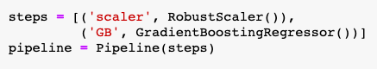



Case Learning #3:
Follow proper procedure.
Make a pipeline
Apply transforms (scaling)
Apply an estimator (regression)
Define grid search parameters
Instantiate cross-validator
Apply grid search
Notes:
But by far my biggest breakthrough in this investigation Case Learning #3, when I learned how to make pipelines and practiced using use the GridSearchCV module in sklearn.
Based on my investigation, these are the proper steps when training and tuning the hyperparameters of an ML model.
First, you make a pipeline, which starts with different transforms. For example, when I included Robust Scaling, it automatically fits only on the training set, before transforming the test set, thus avoiding data leakage. In a pipeline you can add more pre-processing steps, like one hot encoding, imputing missing values, etc. But the important thing is to end your pipeline with an estimator, which is your regression or classification model.
Second step is to define the grid search parameters, which is particularly useful for optimizing models like Gradient Boosting Method, which involves a lot of hyperparameters.
Then, you instantiate your cross-validator object, and
finally create GridsearchCV object. This is amazing when used with a Pipeline oobject because it automatically performs every step correctly on your training and validation sets: scaling, regression, cross-validation, and hyperparameter tuning.
Although it took me a long time to figure out, the code turned out to be surprisingly simple and powerful, and doesn’t even require any for-loops.

Slide 6

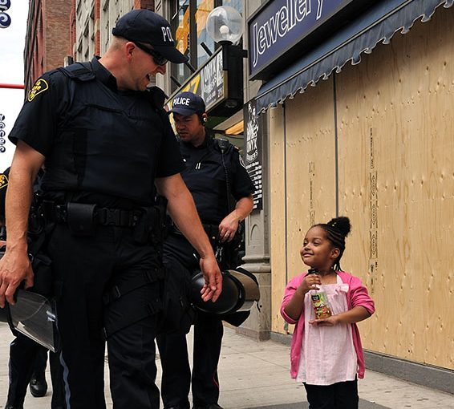

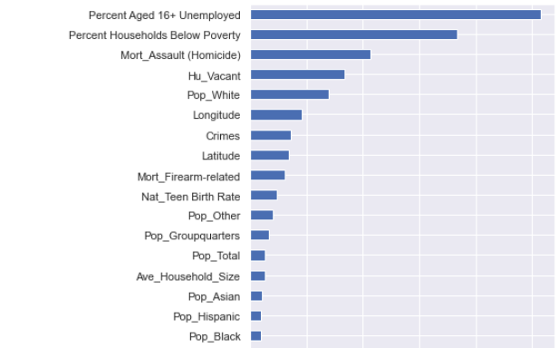
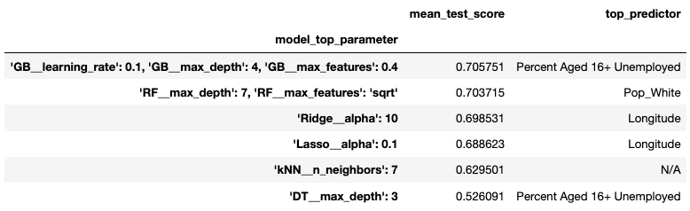
To build trust with the public, interpretability is key.
Case Learning #4:
Model: Gradient Boosting Method
✘
Notes:
My final learning was of course on the results. Interestingly, I found different models yielded different rankings of the top predictor variables. Here I show the results of Gradient Boosting Method, my most accurate model. But looking at the top models which scored closely on accuracy , I found some common themes.
Generally, the top predictors of a community’s trust in police are
- firstly, poverty levels, especially in terms of unemployment
the proportion of the population that are white or Caucasian, so race plays a factor
Third, the percentage of housing units that remain vacant
Fourth, the per capita number of deaths in the community due to homicide
and the location. In Chicago, the farther east you go, the richer the communities become as you approach the lake, so this also came out in the results
I really like that these results told a story, because I think that for many ML use cases, interpretability is key if you want your model to be accepted by your stakeholders. So for example, kNN here is useless because it’s instance based and tells you nothing about the top predictors.

Slide 7

ML1
Thank you.
Notes:
And that concludes my investigation. Some mysteries may appear daunting, but with proper sifting of evidence and a thorough, methodical investigation, you can solve any mystery. Thank you.

